Slide 1

Microservices

Slide 2
user-service
- User REST Controller
POST /user/checkLogin
POST /user/checkForgotPassword
PUT /user/{id}
- Request REST Controller
POST /request/checkStatus
POST /request
POST /request/validation
share-service
- Share REST Controller
GET /share/divRate
GET /share/{id}
GET /share/account/{id}
GET /share/quarter/{id}
GET /share/wdl/{id}
POST /share/movements
- Recovery REST Controller
GET /recovery/{id}
GET /recovery/startDate/{id}
GET /recovery/modStartDate/{id}
GET /recovery/endDate/{id}
GET /recovery/terminateDate/{id}
POST /recovery/change
loan-service
- Loan REST Controller
GET /loan/loanType
GET /loan/{id}
GET /loan/movements/{id}
GET /loan/checkPending/{id}
PUT /loan/{id}
Repay REST Controller
POST /repay/serviceAvailability
POST /repay/calculateInterest
POST /repay/calculateRepayment
POST /repay/check
POST /repay
account-service
- Account REST Controller
GET /account/{id}
GET /account/active/{id}
GET /account/deleted/{id}
GET /account/rejected/{id}
POST /account
PUT /account/close/{id}
PUT /account/ {id}
DELETE /account/{id}
- Withdrawal REST Controller
POST /withdrawal/checkFundMovement
POST /withdrawal/check
POST /withdrawal/withdraw
GET /withdrawal/history/{id}
report-service
jasper report (page: 4, 17,19, 20, 23, 24, 25, 50)
- Report REST Controller
election-service
- Election REST Controller
GET /election/isOpen
GET /election/{id}
POST /election/vote
notification-service
- Mail REST Controller

Slide 3
user-service
User REST Controller
EndPoint | Input | Output | Description
POST /user/checkLogin | indexNum, password | User DTO | Step 1 Login
POST /user/checkForgotPassword | indexNum, Date of birth | User DTO | Step 1 Forgot Password
PUT /user/{id} | User DTO | User DTO | Step 4: Save password , Step 2: Reset password, Hide Message, Change my password, Change my email, Change my challenge questions
Request REST Controller
EndPoint | Input | Output | Description
POST /request/checkStatus | indexNum, Date of birth | RequestStatus DTO | Step 1 Registration
POST /request | Request DTO | Request DTO | Step 2: Save Agreement , Q&A, email and phone
POST /request/validation | indexNum, vt | Request DTO | Step 3: After clicking on the sent link

Slide 4
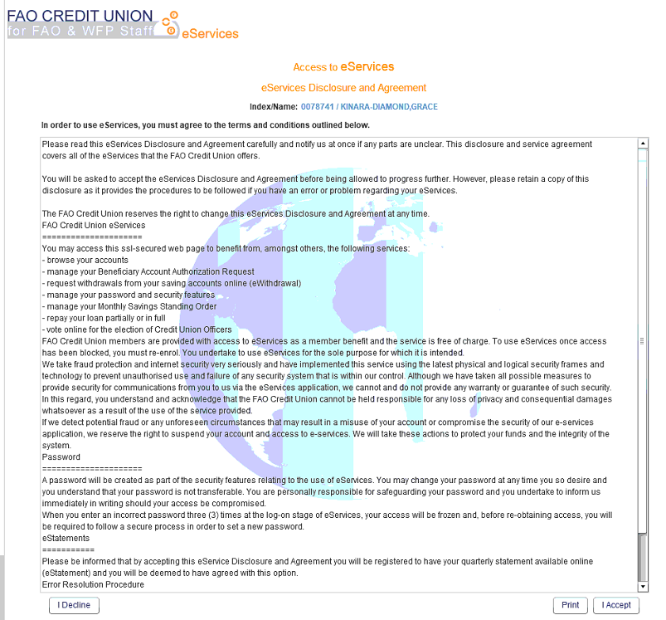
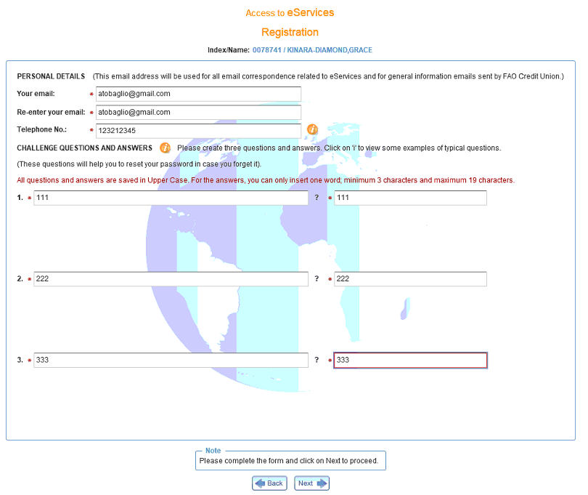
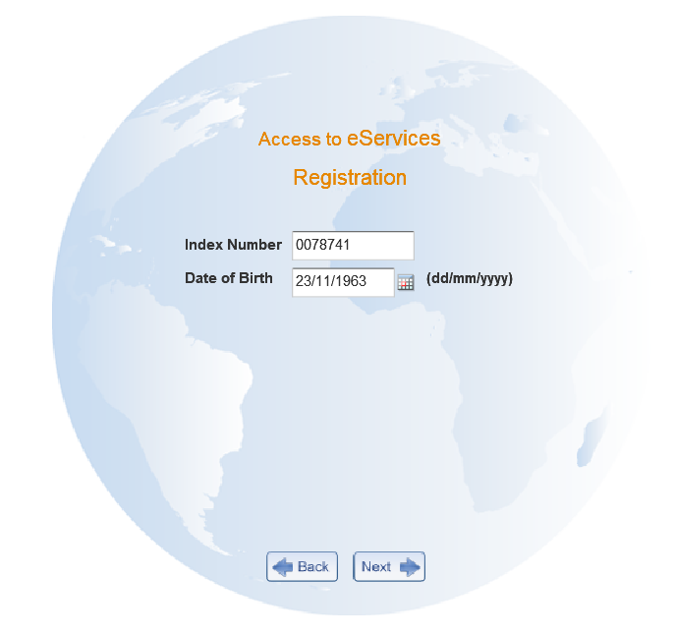
Step 1 Registration
POST /request/checkStatus
IN
{
"indexNo" : "0019646",
"dob" : "1965-01-05"
}
OUT
{
"statusInd": "A",
"msg": "Please read this eServices Disclosure and Agreement carefully and notify us at once if any parts are unclear. This disclosure and service agreement covers all of the eServices that the FAO ………….",
"indexNum": "0019646",
"longName": "WALTERS,NANCY",
"email": null
}
jasper report eServAgreement.jrxml
USER MUST AGREE AND SET PHONE EMAIL AND DEFINE THE Q&As

Slide 5
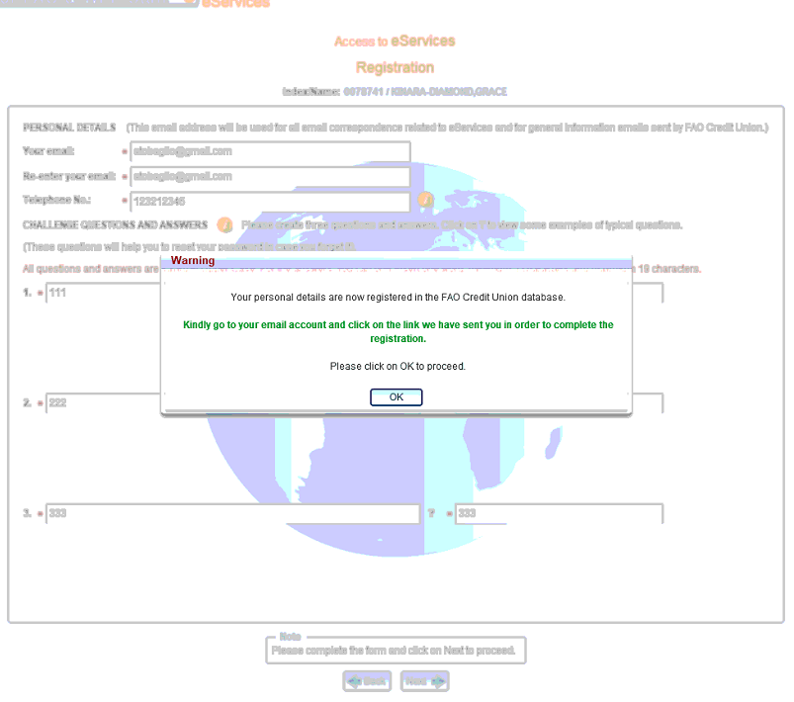
Step 2: Save Agreement , Q&A, email and phone
POST /request
IN
{
"indexNum": "0019646",
"telephoneNo": "2332456",
"emailAddr": "antonella.baglioni@fao.org",
"questions": [
{
"qSeq": 1,
"indexNum": "0019646",
"question": "NAME OF YOUR STREET",
"answer": "111"
},
{
"qSeq": 2,
"indexNum": "0019646",
"question": "NAME OF YOUR MOTHER",
"answer": "111"
},
{
"qSeq": 3,
"indexNum": "0019646",
"question": "FAVOURITE ICE CREAM",
"answer": "111"
}
]
}
OUT
{
"statusInd": null,
"msg": "Your personal details are now registered in the FAO Credit Union database. Kindly go to your email account and click on the link we have sent you in order to complete the registration.",
"indexNum": null,
"longName": null,
"email": null
}
USER RECEIVES AN EMAIL WITH THE VALIDATION TEXT

Slide 6
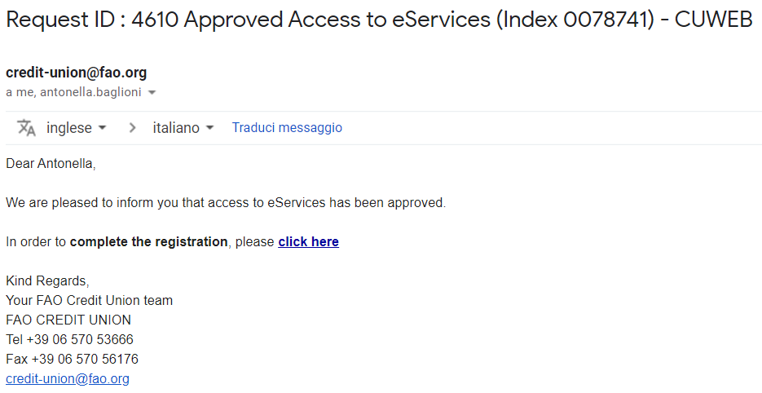
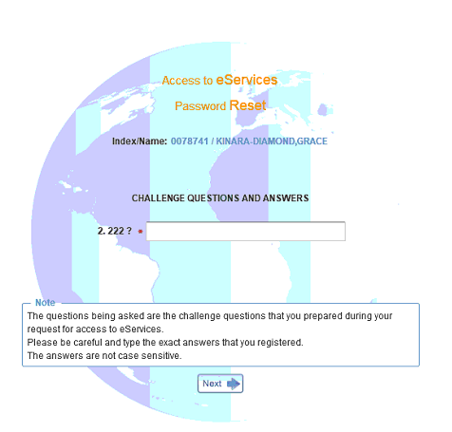
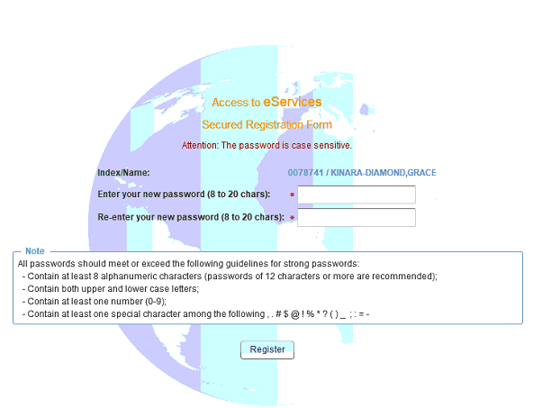
Step 3: After clicking on the sent link
POST /request/validation
OUT
{
"indexNum": "0019646",
"emailAddr": "antonella.baglioni@fao.org",
"telephoneNo": null,
"longName": "WALTERS,NANCY",
"questions": [
{
"qSeq": 1,
"indexNum": "0019646",
"question": "NAME OF YOUR STREET",
"answer": "111"
},
{
"qSeq": 2,
"indexNum": "0019646",
"question": "NAME OF YOUR MOTHER",
"answer": "111"
},
{
"qSeq": 3,
"indexNum": "0019646",
"question": "FAVOURITE ICE CREAM",
"answer": "111"
}
]
}
IN
{
"indexNo" : "0019646",
"vt" : "qkGGJ74zms"
}
USER MUST REPLY THE QUESTIONS BEFORE SETTING THE PASSWORD

Slide 7
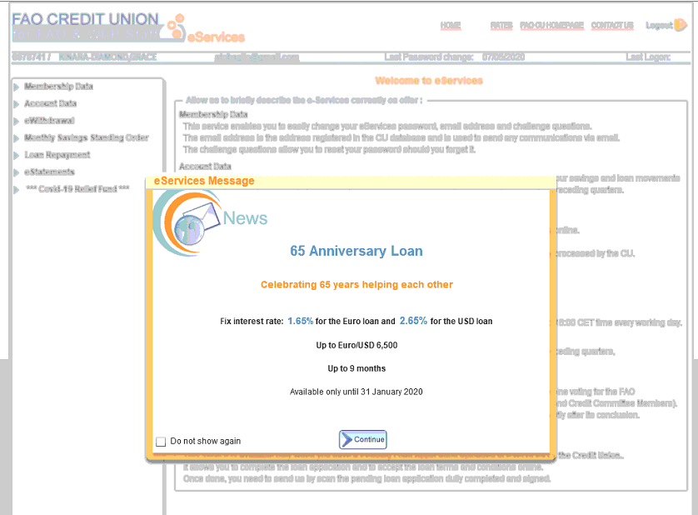
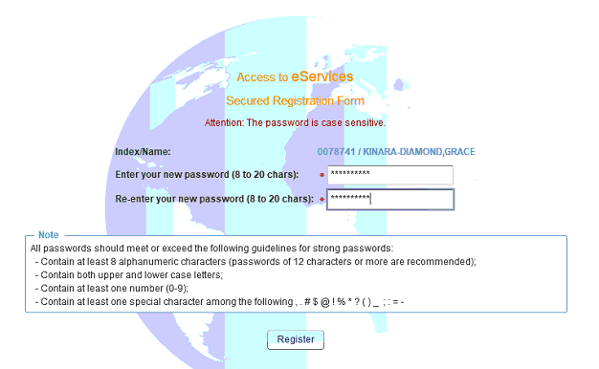
Step 4: Save password
PUT /user/0019646
OUT
{
"indexNum": "0019646",
"password": null,
"membershipLongName": "WALTERS,NANCY",
"membershipOrg": "FAO ",
"emailAddr": "antonella.baglioni@fao.org",
"lastLogOn": "2020-05-06T04:35:41.166+0000",
"lastDate": "2020-05-06T04:35:41.166+0000",
"lastPwdChanged": "2020-05-06T04:35:41.166+0000",
"membershipStatusFlag": "APPR",
"membershipStatusDate": null,
"questions": null,
"messages": [
{
"msgId": "AL",
"validFrom": "2019-12-09T23:00:00.000+0000",
"validTo": "2020-12-30T23:00:00.000+0000",
"msgTitle": "65 Anniversary Loan",
"msgText": "<br><b…..
}
],
"msgId": null
}
IN
{
"password" : "Sicilia.01"
}
USER LOGGED IN

Slide 8
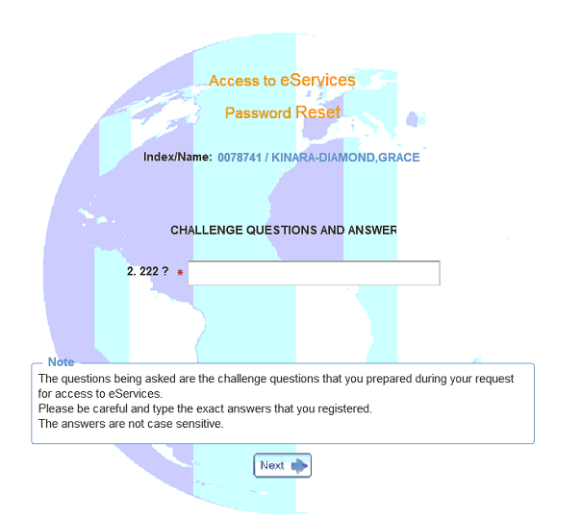
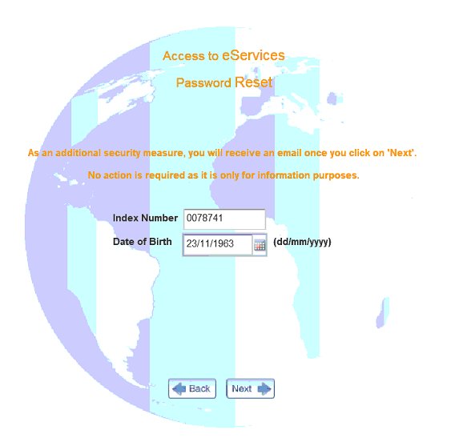
Step 1 Forgot Password
POST /user/checkForgotPassword
OUT
{
"indexNum": "0019646",
"password": null,
"membershipLongName": "WALTERS,NANCY",
"membershipOrg": "FAO ",
"emailAddr": "antonella.baglioni@fao.org",
"lastLogOn": "2020-05-06T04:35:41.000+0000",
"lastDate": "2020-05-06T04:35:41.000+0000",
"lastPwdChanged": "2020-05-06T04:35:41.000+0000",
"membershipStatusFlag": "APPR",
"membershipStatusDate": null,
"questions": [
{
"qSeq": 1,
"indexNum": "0019646",
"question": "NAME OF YOUR STREET",
"answer": "111"
},
{
"qSeq": 2,
"indexNum": "0019646",
"question": "NAME OF YOUR MOTHER",
"answer": "111"
},
{
"qSeq": 3,
"indexNum": "0019646",
"question": "FAVOURITE ICE CREAM",
"answer": "111"
}
],
"messages": null,
"msgId": null
}
IN
{
"indexNo" : "0019646",
"dob" : "1965-01-05"
}
USER MUST REPLY CORRECTLY THE QUESTIONS BEFORE RESETTING THE PASSWORD

Slide 9
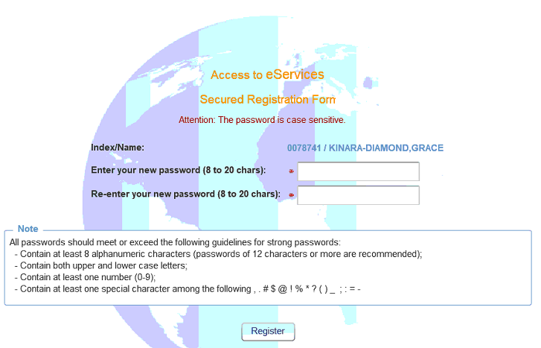
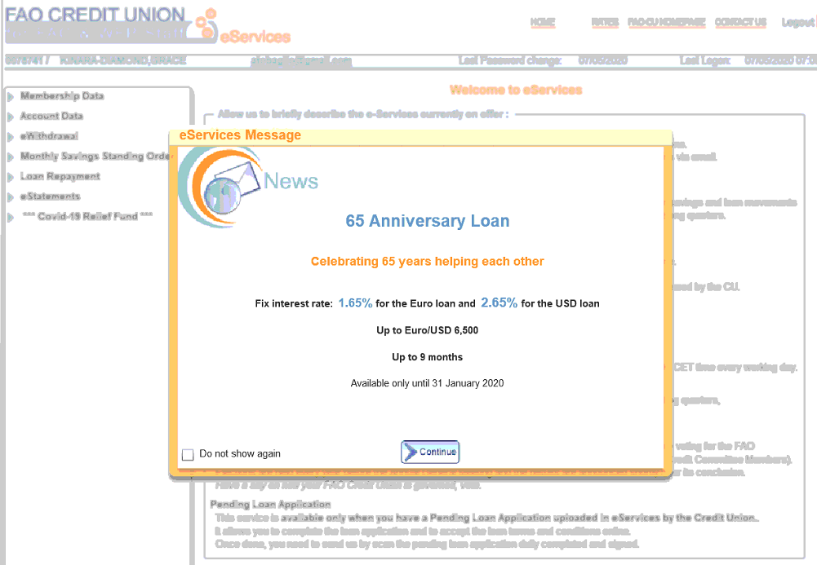
Step 2: Reset password
PUT /user/0019646
OUT
{
"indexNum": "0019646",
"password": null,
"membershipLongName": "WALTERS,NANCY",
"membershipOrg": "FAO ",
"emailAddr": "antonella.baglioni@fao.org",
"lastLogOn": "2020-05-06T04:57:16.127+0000",
"lastDate": "2020-05-06T04:57:16.127+0000",
"lastPwdChanged": "2020-05-06T04:57:16.127+0000",
"membershipStatusFlag": "APPR",
"membershipStatusDate": null,
"questions": null,
"messages": [
{
"msgId": "AL",
"validFrom": "2019-12-09T23:00:00.000+0000",
"validTo": "2020-12-30T23:00:00.000+0000",
"msgTitle": 65 Anniversary Loan",
"msgText": ….31 January 2020 ….."
}
],
"msgId": null
}
IN
{
"password" : "Sicilia.02"
}
USER LOGGED IN

Slide 10
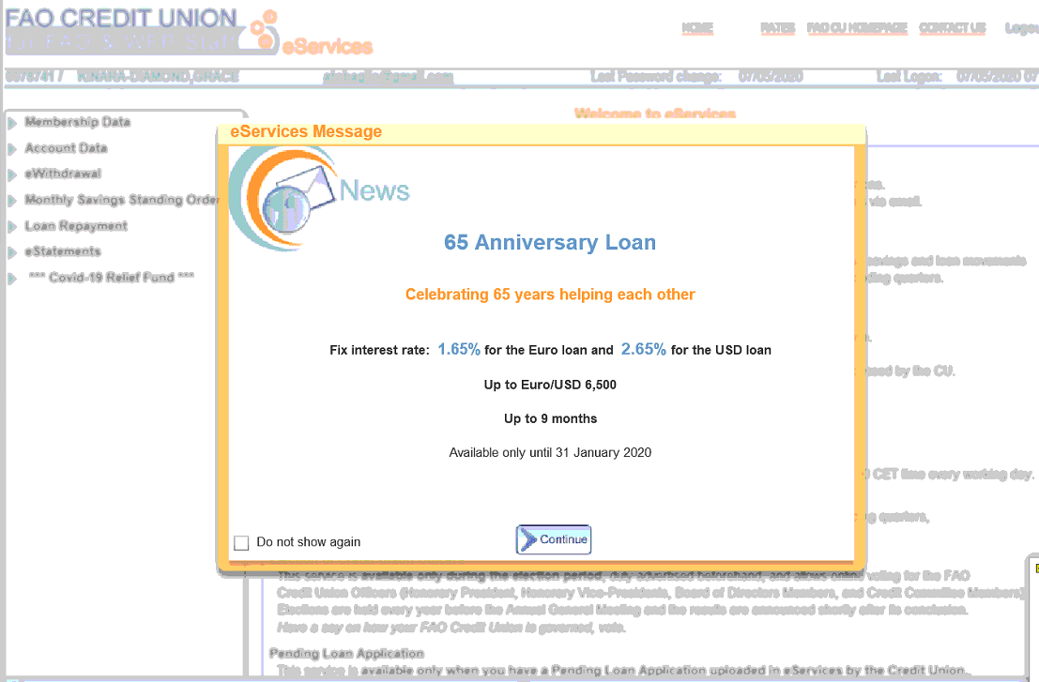
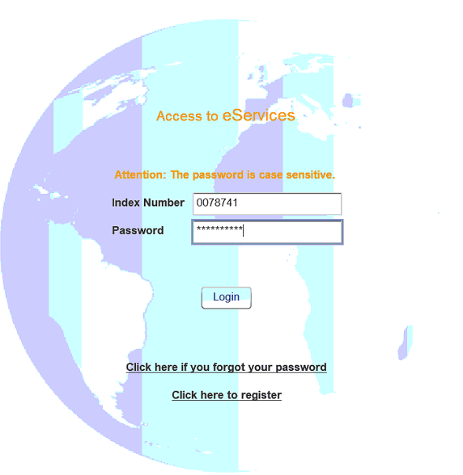
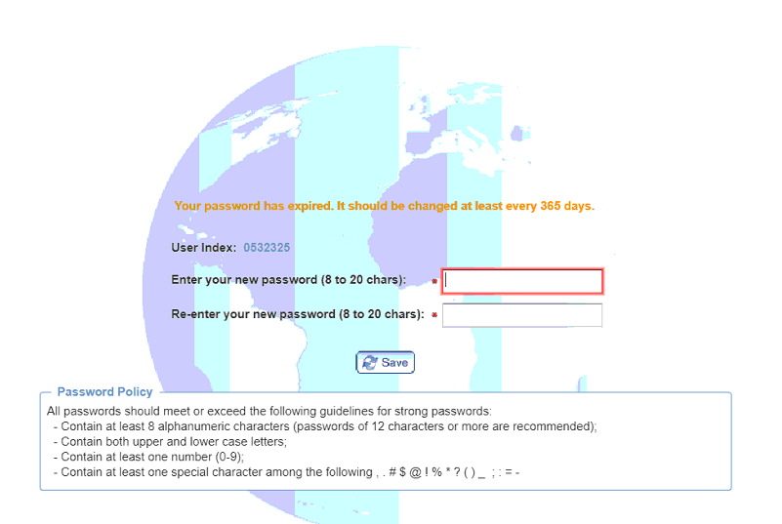
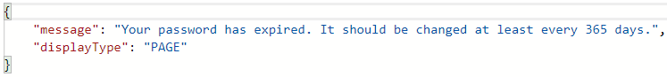
Step 1 Login
POST /user/checkLogin
USER LOGGED IN
IN
{
"indexNo" : "0019646",
"pwd" : "Sicilia.02"
}
OUT
{
"indexNum": "0019646",
"password": null,
"membershipLongName": "WALTERS,NANCY",
"emailAddr": "antonella.baglioni@fao.org",
"lastLogOn": "2020-05-06T05:06:06.261+0000",
"lastDate": "2020-05-06T04:57:16.000+0000",
"lastPwdChanged": "2020-05-06T04:57:16.000+0000",
"membershipStatusFlag": "APPR",
"membershipStatusDate": null,
"questions": null,
"messages": [
{
"msgId": "AL",
"validFrom": "2019-12-09T23:00:00.000+0000",
"validTo": "2020-12-30T23:00:00.000+0000",
"msgTitle": "65 Anniversary Loan",
"msgText": "Celebrating 65 years helping"
}
],
"msgId": null
}

Slide 11
Hide Message
PUT /user/0019646
IN
{
"msgId" : "AL"
}
OUT
{
"indexNum": "0019646",
"password": null,
"membershipLongName": null,
"emailAddr": "antonella.baglioni@fao.org",
"lastLogOn": "2020-05-06T05:06:06.000+0000",
"lastDate": "2020-05-06T04:57:16.000+0000",
"lastPwdChanged": "2020-05-06T04:57:16.000+0000",
"membershipStatusFlag": null,
"membershipStatusDate": null,
"questions": null,
"messages": [],
"msgId": null
}
Checking this box, user is asking to not show this message when he logs in again

Slide 12
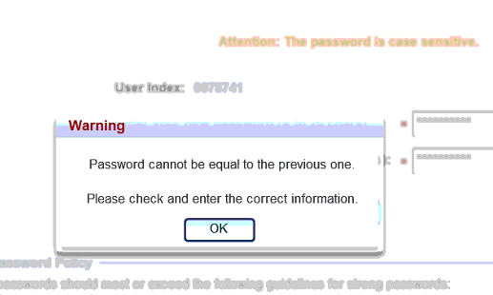
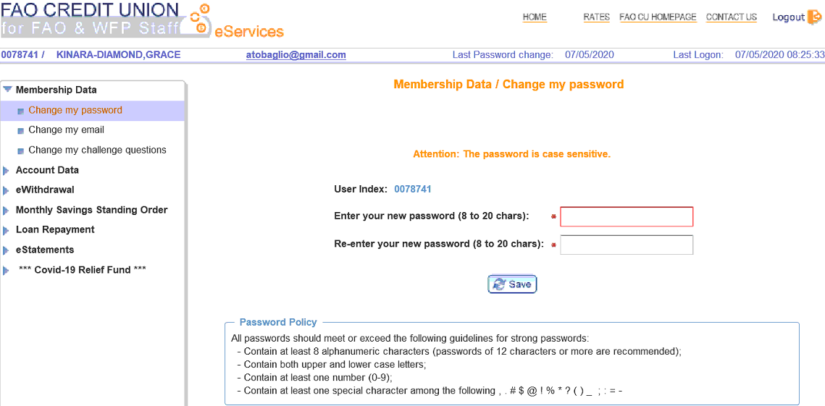
Change my password
PUT /user/0019646
OUT 400 Bad Request
{
"message": "Password cannot be equal to the previous one. Please check and enter the correct information.",
"displayType": "ALERT"
}
IN
{
"password" : "Sicilia.03"
}
OUT
{
"indexNum": "0078741",
"password": null,
"membershipLongName": "KINARA-DIAMOND,GRACE",
"emailAddr": "atobaglio@gmail.com",
"lastLogOn": "2020-05-07T07:06:43.634+0000",
"lastDate": "2020-05-07T07:06:43.634+0000",
"lastPwdChanged": "2020-05-07T07:06:43.634+0000",
"membershipStatusFlag": "APPR",
"membershipStatusDate": null,
"questions": null,
"messages": [],
"msgId": null
}
NOTE: Password policy check not implemented on the back-end

Slide 13
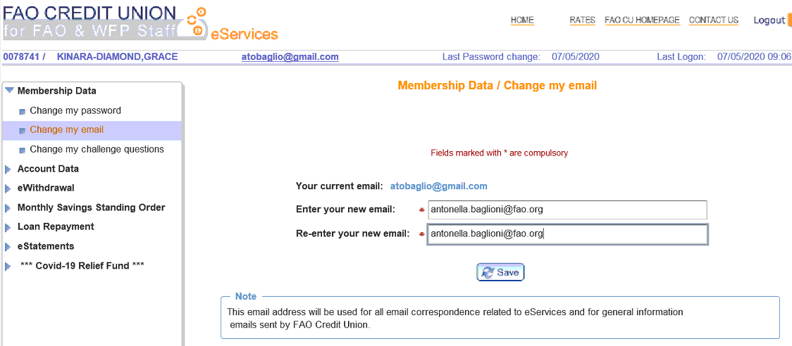
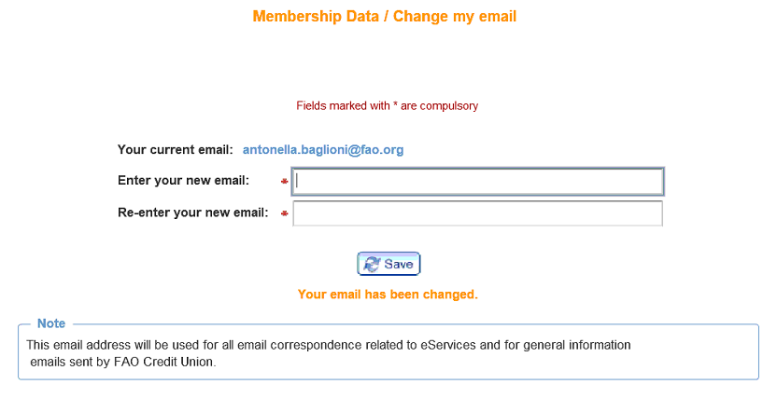
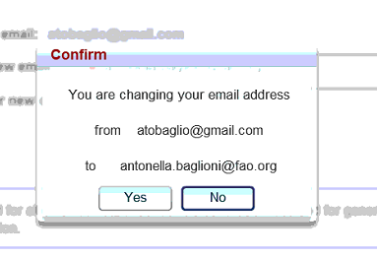
Change my email
PUT /user/0019646
IN
{
"emailAddr" : "antonella.baglioni@fao.org"
}
OUT
{
"indexNum": "0078741",
"password": null,
"membershipLongName": null,
"emailAddr": "antonella.baglioni@fao.org",
"lastLogOn": "2020-05-07T07:06:43.000+0000",
"lastDate": "2020-05-07T07:13:25.095+0000",
"lastPwdChanged": "2020-05-07T07:06:43.000+0000",
"membershipStatusFlag": null,
"membershipStatusDate": null,
"questions": null,
"messages": [],
"msgId": null
}

Slide 14
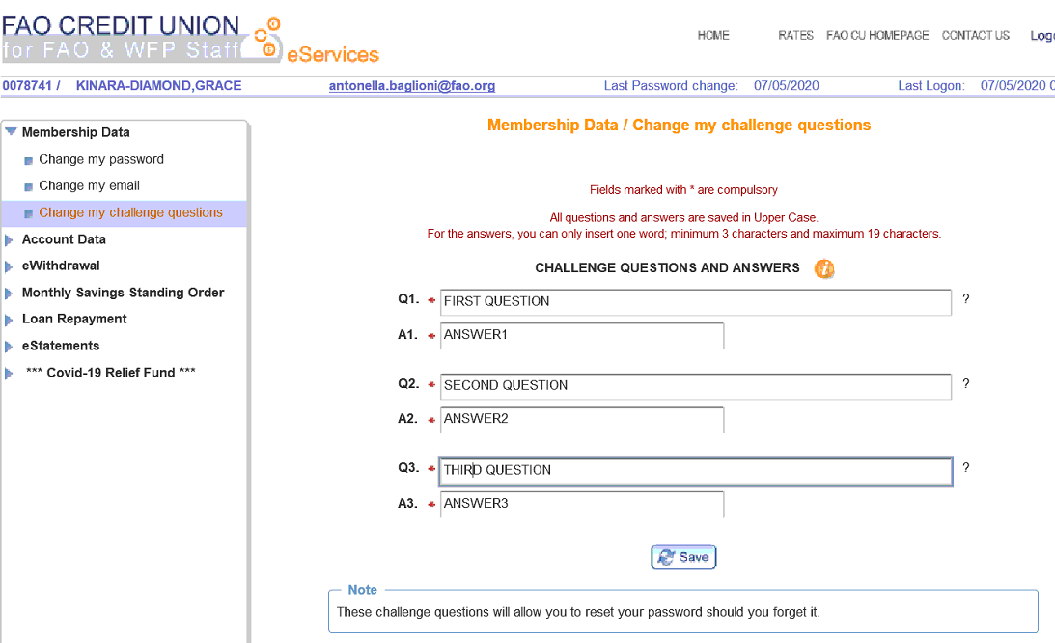
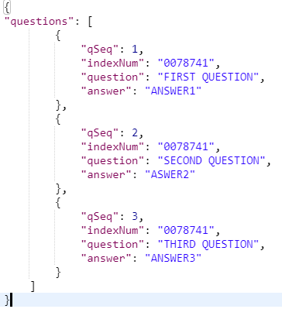
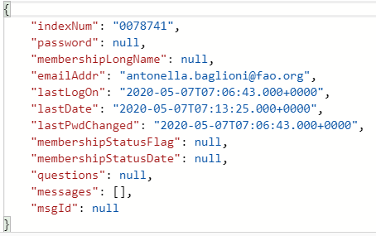
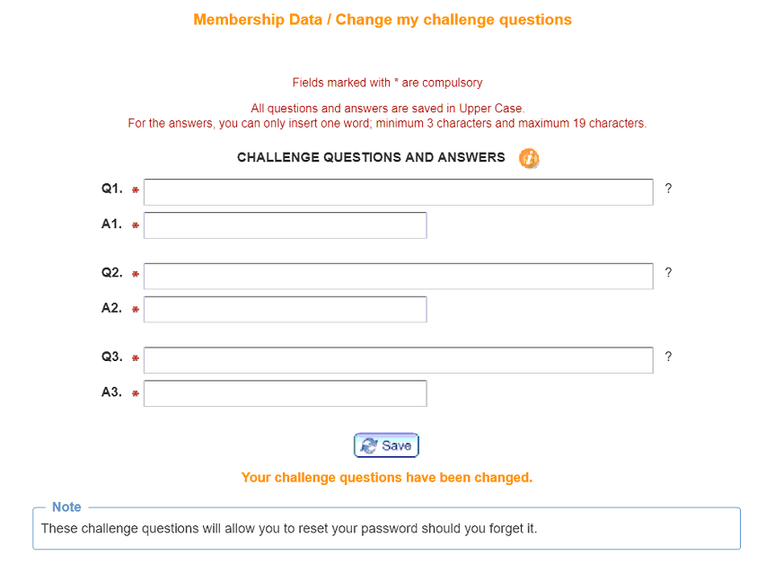
Change my challenge questions
PUT /user/0019646
IN
OUT

Slide 15
share-service
Share REST Controller
EndPoint | Input | Output | Description
GET /share/divRate |  | List<WSharesDivRate> | RATES link
GET /share/{id} |  | List<SharesHd> | Load Account Data Menu
GET /share/account/{id} |  | List<SharesHd> (with 3 Transient fields) | Account Data / Overall View , Loan Repayment / Share to Loan, Step 1 eWithdrawal/ Submit eWithdrawal
GET /share/quarter/{id} |  | List<WQuarterByIndex> | Load eStatements Menu
GET /share/wdl/{id} |  | SharesWdlDto | Account Data / Overall View
POST /share/movements |  | SharesMvmtDto | Account Data / Share CCY
Recovery REST Controller
EndPoint | Input | Output | Description
GET /recovery/{id} |  | MonthlySavingDto | Monthly Saving Standing Order / Manage Monthly Savings
GET /recovery/startDate/{id} |  | List<String> | polulate Start Month and End Month
GET /recovery/modStartDate/{id} |  | List<String> | polulate Start Month and End Month
GET /recovery/endDate/{id} |  | List<String> | polulate Start Month and End Month
GET /recovery/terminateDate/{id} |  | List<String> | polulate Start Month and End Month
POST /recovery/change | RecoveryDto | String | Submit or Terminate OK button click

Slide 16
loan-service
Loan REST Controller
EndPoint | Input | Output | Description
GET /loan/loanType |  | List<WLoansType> | RATES link
GET /loan/{id} |  | List<LoansHd> | Load Account Data Menu , Account Data / Overall View
GET /loan/movements/{id} |  | LoansMvmtDto | Account Data / Loan 94347
GET /loan/checkPending/{id} |  | CuwebLpdt | Pending Loan Application
PUT /loan/{id} |  | CuwebLpdt | Pending Loan Application / Loan 95680, Loan Repayment / Share to Loan
Repay REST Controller
EndPoint | Input | Output | Description
POST /repay/serviceAvailability |  | AvailabilityDto | Step 0 Loan Repayment / Share to Loan
POST /repay/calculateInterest | InterestInDto | InterestOutDto | Step 1 Loan Repayment Transaction
POST /repay/calculateRepayment | RepaymentOutDto | RepaymentInDto | Step 2 Loan Repayment Transaction / Calculate Repayment
POST /repay/check | RepayCheckDto | String | Step 3 Loan Repayment Transaction / Repay Check
POST /repay | HttpServletRequest, repayDto | String | Step 4 Loan Repayment Transaction / Clicking OK

Slide 17
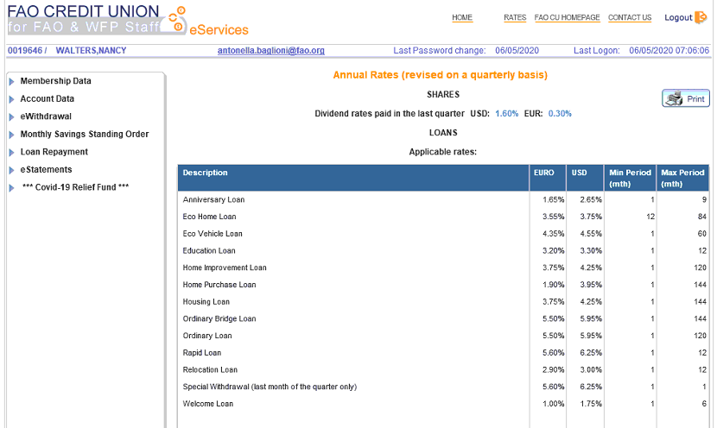
RATES link
jasper report ratePol.jrxml
/share/divRate
OUT
[
{
"ccyCode": "USD",
"startDate": "2019-03-28T23:00:00.000+0000",
"endDate": "9999-12-30T23:00:00.000+0000",
"rate": " 1.60%"
},
{
"ccyCode": "EUR",
"startDate": "2018-12-19T23:00:00.000+0000",
"endDate": "9999-12-30T23:00:00.000+0000",
"rate": " 0.30%"
}
]
/loan/loanType
[
{
"type": "AL",
"startDate": "2019-11-17T23:00:00.000+0000",
"endDate": "9999-12-30T23:00:00.000+0000",
"shrtDc": "Anniversary Loan",
"minTerm": 1,
"maxTerm": 9,
"usdIntRate": " 2.65%",
"euroIntRate": " 1.65%"
},
…
]

Slide 18
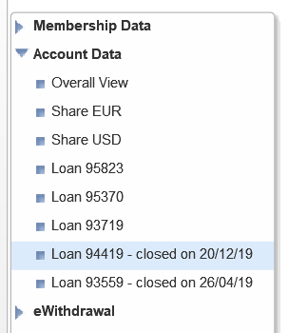
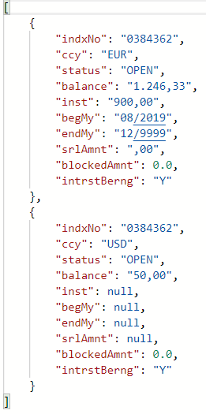
Load Account Data Menu
GET /share/0019646
GET /loan/0019646
OUT share
OUT loan
[
{
"loanNo": 95370,
"indxNo": "0384362",
"ccyCd": "EUR",
"typeCd": "OL",
"typeDesc": "Ordinary Loan",
"originalAmnt": "43.630,66",
"principalOs": "42.766,44",
"fromDate": "01/2020",
"toDate": "05/2025",
"instlmnt": "777,71",
"term": 65,
"lnTitle": "Loan 95370",
"sh": "Y",
"lastValueDate": "2020-01-28T23:00:00.000+0000",
"acrdIntrst": 0.0,
"rate": " 5.50%"
},
…
]

Slide 19
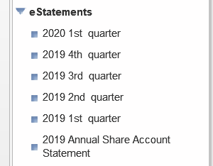
Load eStatements Menu
GET /share/quarter/0019646
jasper report eStatement.jrxml (params: pPerdDate, pIndexNo);
jasper report annualInterestStatement.jrxml (params: pPerdDate, pIndexNo);
OUT
[
{
"indexNumber": "0019646",
"quarter": 202003,
"quarterYear": "2020",
"quarterNum": "03",
"quarterDescription": "2020 1st"
},
{
"indexNumber": "0019646",
"quarter": 201912,
"quarterYear": "2019",
"quarterNum": "12",
"quarterDescription": "2019 4th"
},
{
"indexNumber": "0019646",
"quarter": 201909,
"quarterYear": "2019",
"quarterNum": "09",
"quarterDescription": "2019 3rd"
},
..
]
NOTE: Annual Share is visible if there is at least one quarte available and it is always related to currentYear-1

Slide 20
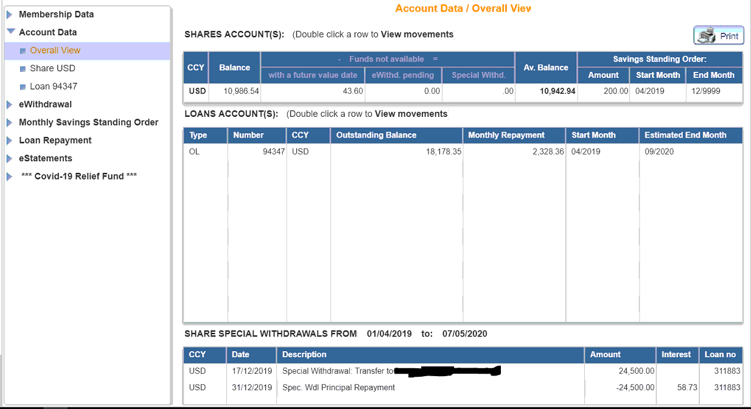
Account Data / Overall View
SHARES ACCOUNT(S) GET /share/account/8801181
LOANS ACCOUNT(S) GET /loan/8801181
SHARE SPECIAL WITHDRAWALS GET /share/wdl/8801181
jasper report overallView.jrxml (params: pIndexNo, pAsAt, pFrom, pName);

Slide 21
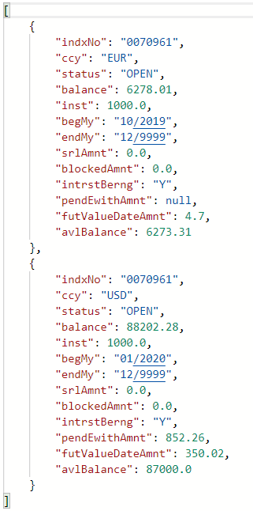
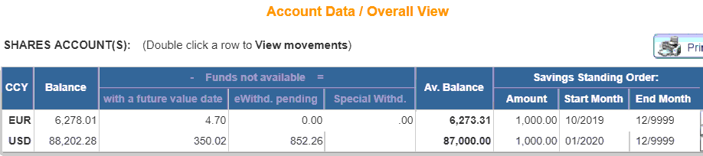
Account Data / Overall View
SHARES ACCOUNT(S) GET /share/account/0070961

Slide 22
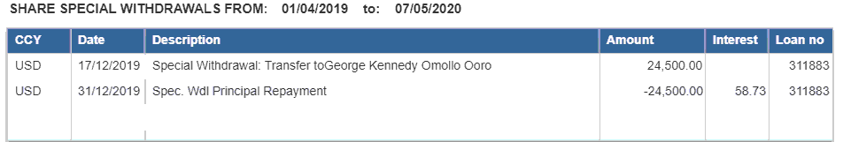
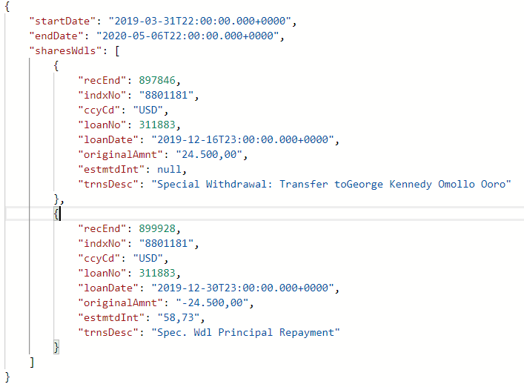
Account Data / Overall View
SHARE SPECIAL WITHDRAWALS GET /share/wdl/8801181

Slide 23
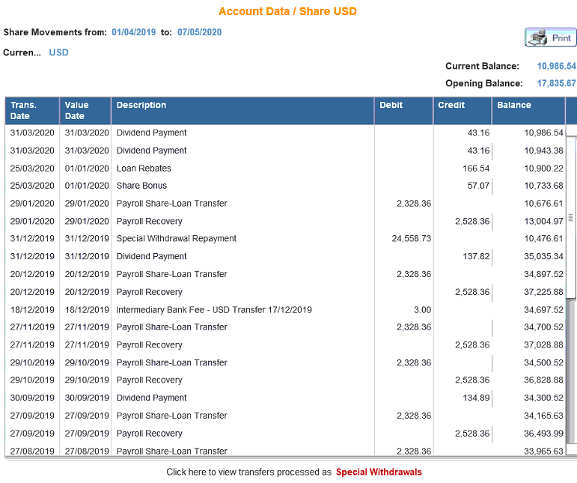
Account Data / Share USD
POST /share/movements/8801181
jasper report share.jrxml (params: pIndexNo, pCcy, pAsAt, pName, pCurrBal, pMovFrom, pBegBal );
{
"indxNo": "8801181",
"ccyCode": "USD",
"startDate": "2019-04-01",
"endDate": "2020-05-07",
"currBalance": 10986.54,
"openBalance": 17878.83,
"srlExists": true,
"shares": [
{
"recEnd": "31-MAR-2031-MAR-2043,16CR903320",
"indxNo": "8801181",
"ccyCode": "USD",
"balanceAmnt": 10986.54,
"acctDate": "2020-03-30T22:00:00.000+0000",
"valueDate": "2020-03-30T22:00:00.000+0000",
"transCode": "BDVD",
"transCodeDesc": "Dividend Payment",
"transFmt": null,
"jurnalNo": 903320,
"transAmount": 43.16,
"amntDrcr": "CR"
},
{
"recEnd": "31-MAR-2031-MAR-2043,16CR903162",
"indxNo": "8801181",
"ccyCode": "USD",
"balanceAmnt": 10943.380000000001,
"acctDate": "2020-03-30T22:00:00.000+0000",
"valueDate": "2020-03-30T22:00:00.000+0000",
"transCode": "BDVD",
"transCodeDesc": "Dividend Payment",
"transFmt": null,
"jurnalNo": 903162,
"transAmount": 43.16,
"amntDrcr": "CR"
},
..
]
}

Slide 24
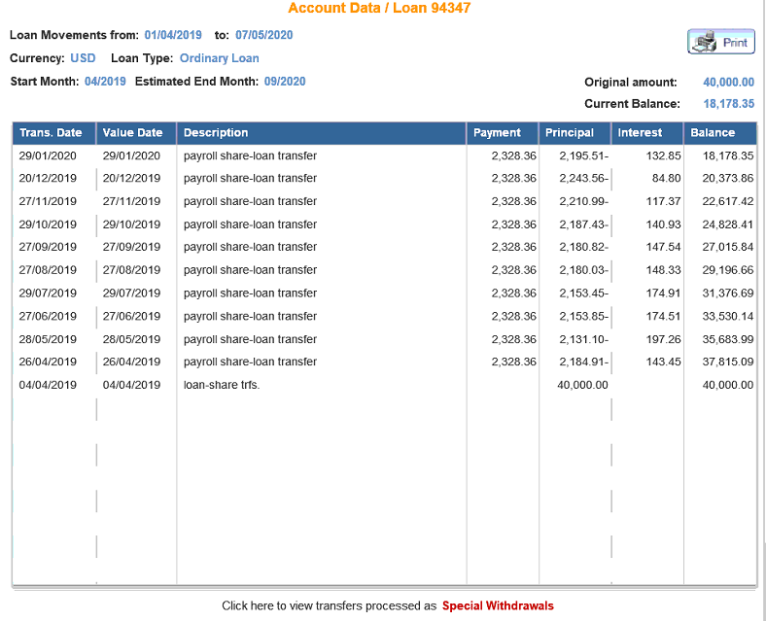
Account Data / Loan 94347
POST /loan/movements/94347
jasper report loan.jrxml (params: pIndexNo, pCcy, pAsAt, pName, pCurrBal, pMovFrom, pFrom, pEstEnd, pOrigAmnt, pLoanNo, pLoanType);
{
"loanNo": 94347,
"ccyCode": "USD",
"indxNo": "8801181",
"startDate": "2019-04-01",
"endDate": "2020-05-07",
"currBalance": 18178.35,
"openBalance": 40000.0,
"srlExists": true,
"loans": [
{
"recEnd": "90285329-GEN-20CR2195,51132,85",
"loanNo": 94347,
"indexNo": "8801181",
"ccyCode": "USD",
"typeLnCd": "OL",
"typeLnDesc": "Ordinary Loan",
"osPrincipal": 0.0,
"acrdInt": 0.0,
"acctDate": "2020-01-28T23:00:00.000+0000",
"valueDate": "2020-01-28T23:00:00.000+0000",
"transCode": "PRSL",
"transDesc": "payroll share-loan transfer",
"jornalNo": 902853,
"amntPrincipal": 2195.51,
"drcrPrincipal": "-",
"amntInt": 132.85,
"drcrInt": null,
"balanceAmnt": 18178.35,
"paymentAmnt": 2328.36,
"curBalance": 18178.35
},
…
},
{.
"amntPrincipal": 40000.0,
"balanceAmnt": 40000.0,
"paymentAmnt": 0.0,
"curBalance": 18178.35
}
]
}
NOTE: Loan Type Start, End Month and Original amount came from the menu link

Slide 25
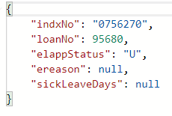
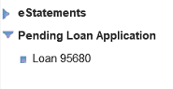
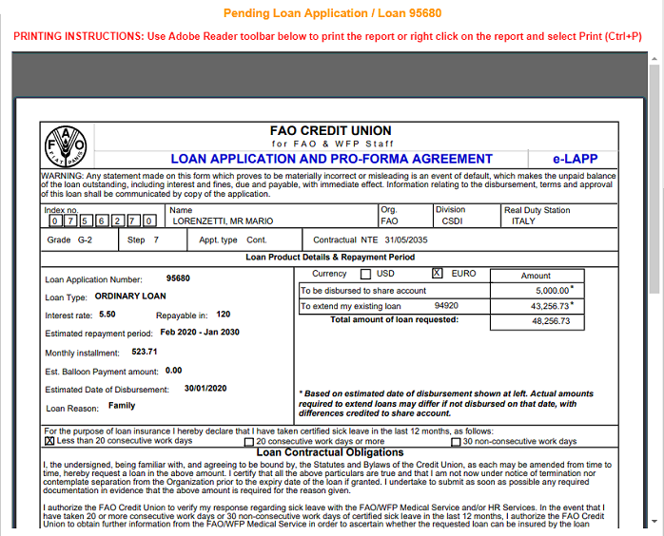
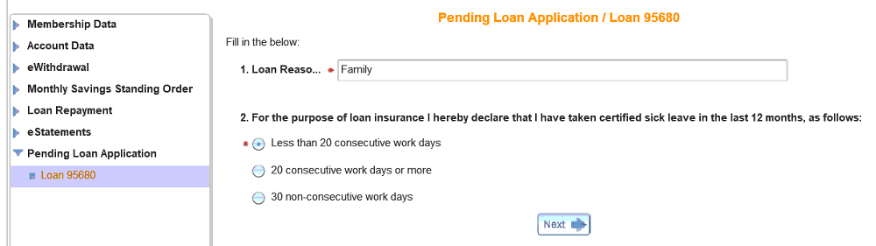
Pending Loan Application
Loan 95680
GET/loan/checkPending/0756270
jasper report LAPP.jrxml (params: pLoanNo);
If elappStatus=U
If elappStatus=S

Slide 26
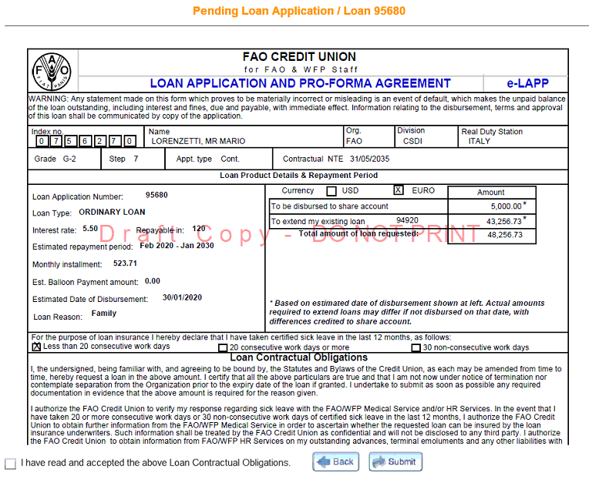
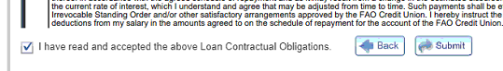
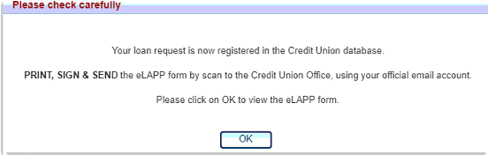
Pending Loan Application / Loan 95680
PUT /loan/95680
IN
{
"ereason" : "Family",
"sickLeaveDays": "LC20"
}
Values:
LC20
NC30
MC20
IN
{
"elappStatus" : "S"
}

Slide 27
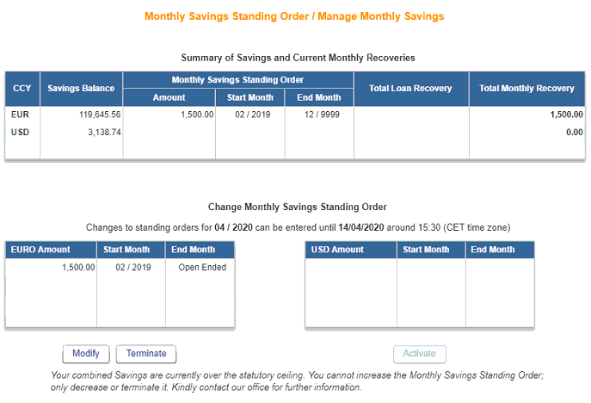
Monthly Saving Standing Order / Manage Monthly Savings
GET /recovery/0364067
{"recoveries": [
{ "ccy": "EUR",
"indxNo": "0364067",
"sharBalnc": 119645.56,
"sInstlm": 1500.0,
"sStart": 201902,
"sEnd": 999912,
"lInstlm": null,
"tInstlm": 1500.0,
"numSq": 0
},
{ "ccy": "USD",
…
}
],
"standOrdEur": [
{ "startDate": 201902,
"indxNo": "0364067",
"ccyCode": "EUR",
"sysDate": "2019-01-15T09:02:22.000+0000",
"sysTrns": "SORD",
"sysServcUser": "0384362",
"sysProcsUser": null,
"endDate": 999912,
"docRefrncNo": null,
"instlmnt": 1500.0,
"term": null,
"cretnDate": "2019-01-14T23:00:00.000+0000"
}
],
"standOrdUsd": null,
"currentPeriod": 202004,
"eurShareInd": "Y",
"usdShareInd": "Y",
"changesTitle": "Changes to standing orders for 202004 can be entered until 14/04/2020 around 15:30 (CET time zone)",
"sepOverTitle": "Your combined Savings are currently over the statutory ceiling. You cannot increase the Monthly Savings Standing Order;only decrease or terminate it. Kindly contact our office for further information.",
"closeDayTitle": null,
"modEnabled": true,
"actEnabled": false,
"termEnabled": true,
"overCeiling": true
}

Slide 28
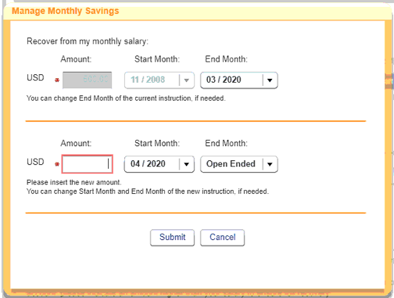
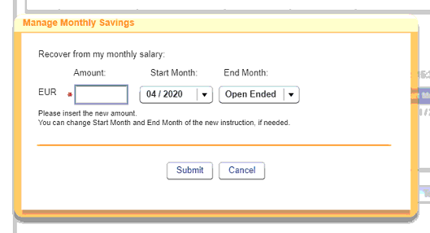
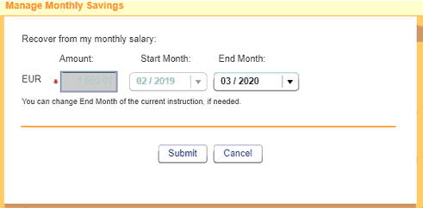
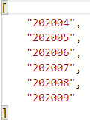
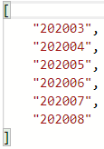


Monthly Saving Standing Order / polulate Start Month and End Month
Terminate^{{currentStandingOrder}}
GET /recovery/terminateDate/20200401
Activate ^{{currentStandingOrder}}
GET /recovery/startDate/20200401
Modify^{{currentStandingOrder}}
GET /recovery/terminateDate/20200401
^{{startMonth}}
GET /recovery/endDate/20200401
^{{startMonth}}
GET /recovery/endDate/20200401
^{{EndMonth}}
GET /recovery/modStartDate/20200301

Slide 29








Monthly Saving Standing Order / Submit or Terminate OK button click
POST /recovery/change

Slide 30



Loan Repayment / Share to Loan
SHARES ACCOUNT(S) GET /share/account/8801181
LOANS ACCOUNT(S) GET /loan/8801181
Message + Button disable GET /repay/serviceAvailability
OUT
Next Button enable
Next Button disable + message

Slide 31






Step 1 Loan Repayment Transaction
POST /calculateInterest
IN
OUT

Slide 32






Step 2 Loan Repayment Transaction / Calculate Repayment
POST /calculateRepayment
IN
OUT

Slide 33




Step 3 Loan Repayment Transaction / Repay Check
POST /repay/check
IN
OUT
OUT
Attention! Based on Credit Union records, it appears that with this transaction your share balance will go to zero and will be closed. Please click on OK to proceed to the next step or Cancel to request lower amount.
NOTE: Case: OK open the pop-up: You are trasfering …
Case message: openo pop-up with OK cancel with the message
OUT – Error Message

Slide 34


Step 4 Loan Repayment Transaction / Clicking OK
POST /repay
IN
OUT
Your request has been processed and journal number is: 903329

Slide 35
account-service
account REST Controller
EndPoint | Input | Output | Description
GET /account/{id} |  | BeneficiaryAccountsDto | eWithdrawal/ Beneficiary Account
GET /account/active/{id} |  | List<WActiveAccounts> | Step 1 eWithdrawal/ Submit eWithdrawal
GET /account/deleted/{id} |  | List<WithdPendingAccts> | eWithdrawal/ Beneficiary Account History
GET /account/rejected/{id} |  | List<WithdPendingAccts> | eWithdrawal/ Beneficiary Account History
POST /account | WithdPendingAccts | WithdPendingAccts | CLICK HERE/Double click on a Ben Acct History row
PUT /account/close/{id} |  | String | Double click on an Active account click Delete
PUT /account/ {id} |  | String | Double click on ACCOUNTS PEND APPROVAL row, click Submit
DELETE /account/{id} | WithdPendingAccts | String | Double click on ACCOUNTS PEND APPROVAL row, click Delete
withdrawal REST Controller
EndPoint | Input | Output | Description
POST /withdrawal/checkFundMovement | FundMonementSearchDto | FundMonementDto | Step 2 eWithdrawal/ Submit eWithdrawal – Next
POST /withdrawal/check | withdrawDto | String | Step 3 eWithdrawal/ Submit eWithdrawal – Transfer Check
POST /withdrawal/withdraw | HttpServletRequest, WithdrawDto | String | Step 4 eWithdrawal/ Submit eWithdrawal – (Transfer) OK
GET /withdrawal/history/{id} |  | List<WSwdlTrnsAccts> | eWithdrawal / eWithdrawal History

Slide 36



eWithdrawal/ Beneficiary Account
GET /account/0111690

Slide 37


eWithdrawal/ Beneficiary Account using calls
GET /account/active/0111690
[
{
"accSeq": 1836,
"validFrom": "2008-04-14T22:00:00.000+0000",
"validTo": "9999-12-30T23:00:00.000+0000",
"indexNo": "0111690",
"accountNo": "000002090X48",
"bank": "Banca Popolare di Sondrio",
"address": "Viale delle Terme di Caracalla 1, 00153",
"city": "Rome",
"country": "IT",
"branch": "Agenzia 29 di Roma, FAO Branch",
"bankCode": "IT09 U056 9603 2290 0000 2090 X48",
"beneficiary": "Jayne Ann Rose",
"beneAddr": "Via Badia di Cava 56, Scala C, Int 1",
"beneCity": "Rome",
"beneCountry": "IT",
"currencyCode": "EUR",
"printedCopyReceivedDate": "2008-04-14T22:00:00.000+0000",
"createdBy": "BOUZAS",
"closedBy": " ",
"addaccinfo": null
},
{
"accSeq": 7509,
"validFrom": "2018-03-06T23:00:00.000+0000",
"validTo": "9999-12-30T23:00:00.000+0000",
"indexNo": "0111690",
"accountNo": "1000/00004060",
"bank": "Intesa SanPaolo",
"address": "Viale delle Terme di Caracalla 00153",
"city": "Rome",
"country": "IT",
"branch": "06825 FAO/WFP Branch",
"bankCode": "IT74 K030 6903 3561 0000 0004 060",
"beneficiary": "Jayne Ann Rose",
"beneAddr": "Via Badia di Cava 56, C3 00142",
"beneCity": "Rome",
"beneCountry": "IT",
"currencyCode": "EUR",
"printedCopyReceivedDate": "2018-03-06T23:00:00.000+0000",
"createdBy": "0780288",
"closedBy": null,
"addaccinfo": null
}
]
GET /account/max
Note: use this value to show the add new account (if sum active and pending less then this value)
DO NOT USE
GET /account/pending/0111690
Note: build the page using only 3 calls

Slide 38






eWithdrawal/ Beneficiary Account / CLICK HERE to add a new Account
or Double click on a Beneficiary Account History record
POST /account
IN
OUT

Slide 39


eWithdrawal/ Beneficiary Account / Double click on ACCOUNTS PENDING APPROVAL row, click on Submit
PUT /account/13036
IN
OUT

Slide 40
eWithdrawal/ Beneficiary Account / Double click on ACCOUNTS PENDING APPROVAL row, click on Delete
DELETE /account/13037
OUT

Slide 41

eWithdrawal/ Beneficiary Account / Double click on an Active account (data already present on the list), click on Delete action
PUT /account/close/1836
OUT

Slide 42




eWithdrawal/ Beneficiary Account History
GET /account/rejected/0111690
GET /account/deleted/0111690
[
{
"reqSeq": 13034,
"accSeqRef": 1836,
"indexNo": "0111690",
"accountNo": "000002090X48",
"bank": "Banca Popolare di Sondrio",
"address": "Viale delle Terme di Caracalla 1, 00153",
"city": "Rome",
"country": "IT",
"branch": "Agenzia 29 di Roma, FAO Branch",
"bankCode": "IT09 U056 9603 2290 0000 2090 X48",
"beneficiary": "Jayne Ann Rose",
"beneAddr": "Via Badia di Cava 56, Scala C, Int 1",
"beneCity": "Rome",
"beneCountry": "IT",
"currencyCode": "EUR",
"submissionDate": "2020-05-25T14:35:14.000+0000",
"actionType": "D",
"statusInd": "A",
"statusDate": "2020-05-25T14:35:14.000+0000",
"addaccinfo": null,
"fCode": null,
"assignTo": null,
"verifiedBy": null,
"regFamType": null
}
]
NOTE: when double click on a row: show the details already present on the output;
For Rejected with Status New and for Deleted open the editable form to insert a new request, For the others only the details not editable.

Slide 43

Step 1 eWithdrawal/ Submit eWithdrawal
SHARES ACCOUNT(S) GET /share/account/ 0111690
ACTIVE BEN. ACCOUNT(S) GET /account/active/0111690

Slide 44



Step 2 eWithdrawal/ Submit eWithdrawal – Next
POST /withdrawal/checkFundMovement
IN
OUT

Slide 45




Step 3 eWithdrawal/ Submit eWithdrawal – Transfer Check
POST /withdrawal/checkTransfer
IN
OUT
OUT
Attention! Based on Credit Union records, it appears that with this transaction your share balance will go to zero and will be closed. Please click on OK to proceed to the next step or Cancel to request lower amount.
NOTE: Case: OK open the pop-up: You are trasfering …
Case message: openo pop-up with OK cancel with the message
OUT – Error Message

Slide 46


Step 4 eWithdrawal/ Submit eWithdrawal – (Transfer) OK
POST /withdrawal/withdraw
IN
OUT

Slide 47


eWithdrawal / eWithdrawal History
GET /withdrawal/history/0111690
[
{
"transSeqNo": 952120
"transSeq": 95212,
"indexNo": "0111690",
"accSeqRef": 7509,
"amount": 5000.0,
"ccyCode": "EUR",
"requestDate": "2020-01-07T11:53:58.000+0000",
"customerRmks": null,
"trnsStatus": "T",
"trnsStatusDesc": "Funds Transferred",
"cuTrnsDate": "2020-01-06T23:00:00.000+0000",
"cuValueDate": "2020-01-07T23:00:00.000+0000",
"cuDjNumber": 900397,
"bankCode": "BCIE",
"fundsMovType": "TRSP",
"remarks": null,
"cuTrnsfDate": "2020-01-07T23:00:00.000+0000",
"voidCode": null,
"cuReversalDjNumber": null,
"reqId": 308381,
"queueInd": "N",
"transNo": 0,
"voidCode": null,
"validFrom": "2018-03-06T23:00:00.000+0000",
"validTo": "9999-12-30T23:00:00.000+0000",
"accountNo": "1000/00004060",
"bank": "Intesa SanPaolo",
"address": "Viale delle Terme di Caracalla 00153",
"city": "Rome",
"country": "IT",
"branch": "06825 FAO/WFP Branch",
"acctBankCode": "IT74 K030 6903 3561 0000 0004 060",
"beneficiary": "Jayne Ann Rose",
"beneAddr": "Via Badia di Cava 56, C3 00142",
"beneCity": "Rome",
"beneCountry": "IT",
"currencyCode": "EUR",
"initReqNum": 11079,
"closeReqNum": null,
"addaccinfo": null
},
NOTE: when double click on a row show the details already present on the output

Slide 48
election-service
Election REST Controller
EndPoint | Input | Output | Description
GET /election/isOpen |  | boolean | Load Election Menu
GET /election/{id} |  | List<Election> | Load Election Ballot
POST /election/vote | BallotDto | String | Vote

Slide 49


Load Election Menu
GET /election/isOpen
OUT
NOTE: Election is visible only during a specific period ONLY FOR APPR member

Slide 50




Load Election Ballot
GET /election/3041672
jasper report ballot.jrxml (params: pYear);
OUT – not yet voted
OUT – already voted

Slide 51


Vote
POST /election/vote
IN
OUT

